Slide 1

KCS056 APPLICATION OF
SOFT COMPUTING
UNIT-2
Prepared By- MR. Ashish Tiwari
ASSISTANT PROFESSOR
DEPARTMENT OF COMPUTER SCIENCE ENGINEERING
UNITED COLLEGE OF ENGG. & RESEARCH, PRAYAGRAJ

Slide 2
Unit -2
Neural Networks-II (Back Propagation Network
Back-Propagation Network, topics : Background, what is back-prop network ? learning AND function, simple learning machines – Error measure, perceptron model Perceptron learning rule, Hidden Layer, Back-Propagation Learning : learning by example, single layer artificial neural network multi-layer feed- forward back-propagation network, computation in input, hidden and output layers, error calculation. Back-propagation algorithm for training network - basic loop structure, step-by-step procedure, numerical example. factors affecting back propagation training, applications.

Slide 3
LECTURE - 3

Slide 4
Outlines of Today's Lecture
Introduction of Perceptron.
How does a Perceptron work?
Structure of a Perceptron.
Where we use Perceptron?
Why do we need Activation Function?
Single layer Perceptron (SLP)
Multilayer Perceptron

Slide 5
Introduction
A human brain has billions of neurons. Neurons are interconnected nerve cells in the human brain that are involved in processing and transmitting chemical and electrical signals. Dendrites are branches that receive information from other neurons.
A perceptron is a neural network unit (an artificial neuron) that does certain computations to detect features or business intelligence in the input data. The perceptron is a mathematical model of a biological neuron. While in actual neurons the dendrite receives electrical signals from the axons of other neurons, in the perceptron these electrical signals are represented as numerical values.
Objectives
After completing this lesson on ‘Perceptron’, you’ll be able to:
Explain artificial neurons with a comparison to biological neurons
Implement logic gates with Perceptron.
Describe the meaning of Perceptron.

Slide 6
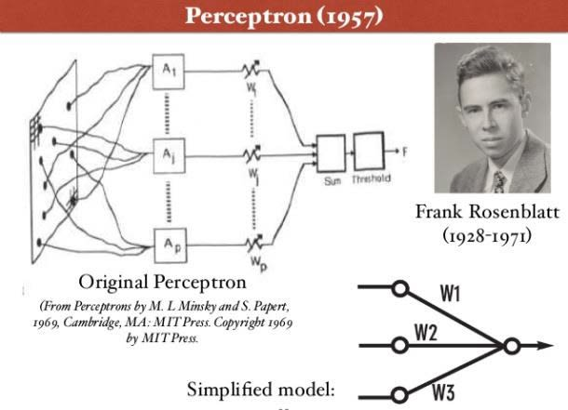
Perceptron was introduced by Frank Rosenblatt in 1957. He proposed a Perceptron learning rule based on the original MCP neuron.
A Perceptron is an algorithm for supervised learning of binary classifiers. This algorithm enables neurons to learn and processes elements in the training set one at a time.

Slide 7
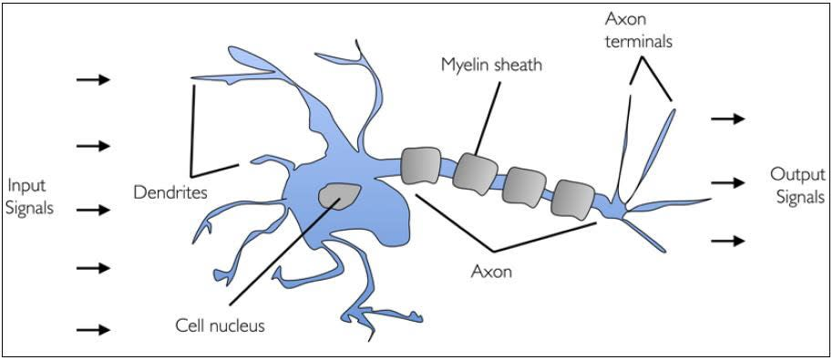

Slide 8
Cell nucleus or Soma processes the information received from dendrites. Axon is a cable that is used by neurons to send information. Synapse is the connection between an axon and other neuron dendrites.
Rise of Artificial Neurons
Researchers Warren McCullock and Walter Pitts published their first concept of simplified brain cell in 1943. This was called McCullock-Pitts (MCP) neuron. They described such a nerve cell as a simple logic gate with binary outputs.
Multiple signals arrive at the dendrites and are then integrated into the cell body, and, if the accumulated signal exceeds a certain threshold, an output signal is generated that will be passed on by the axon.
An artificial neuron is a mathematical function based on a model of biological neurons, where each neuron takes inputs, weighs them separately, sums them up and passes this sum through a nonlinear function to produce output.

Slide 9
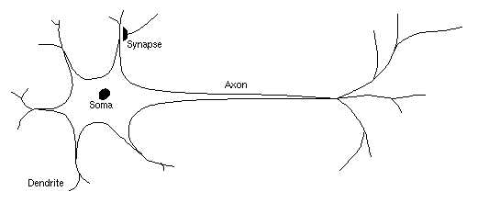
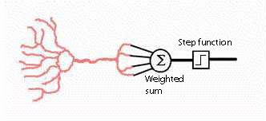
A biological neuron
An artificial neuron (perceptron)

Slide 10
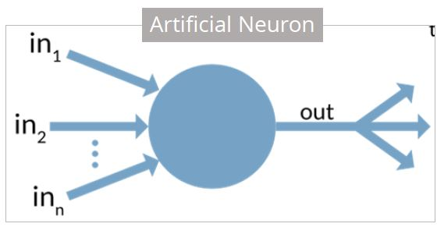

Slide 11
Biological Neuron vs. Artificial Neuron
The biological neuron is analogous to artificial neurons in the following terms:
Biological Neuron | Artificial Neuron
Cell Nucleus (Soma) | Node
Dendrites | Input
Synapse | Weights or interconnections
Axon | Output

Slide 12
LECTURE - 4

Slide 13
Artificial Neuron at a Glance
The artificial neuron has the following characteristics:
1. A neuron is a mathematical function modeled on the working of biological neurons.
2. It is an elementary unit in an artificial neural network
3. One or more inputs are separately weighted
4. Inputs are summed and passed through a nonlinear function to produce output
5. Every neuron holds an internal state called activation signal
6. Each connection link carries information about the input signal
7. Every neuron is connected to another neuron via connection link

Slide 14
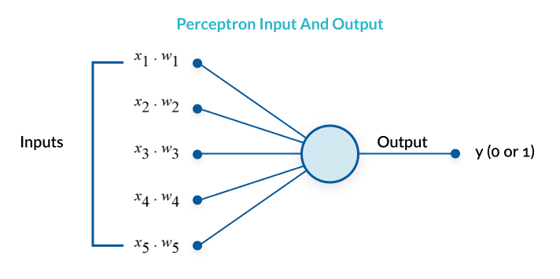
What is a Perceptron?
A Perceptron is an algorithm used for supervised learning of binary classifiers. Binary classifiers decide whether an input, usually represented by a series of vectors, belongs to a specific class.
In short, a perceptron is a single-layer neural network. They consist of four main parts including input values, weights and bias, net sum, and an activation function.

Slide 15
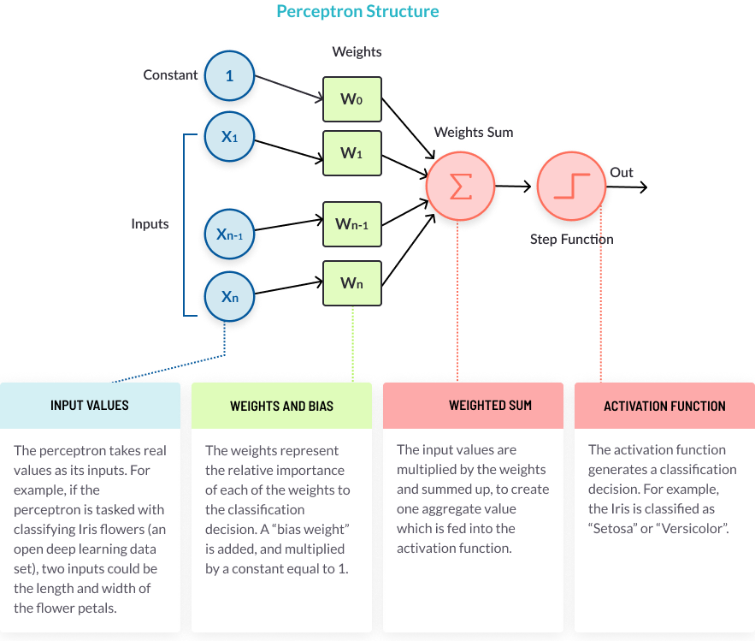
Structure of a Perceptron
The perceptron, or neuron in a neural network, has a simple but ingenious structure. It consists of four parts, illustrated below.

Slide 16
The Perceptron Learning Process
A perceptron follows these steps:
Takes the inputs, multiplies them by their weights, and computes their sum the weights allow the perceptron to evaluate the relative importance of each of the outputs.
Adds a bias factor, the number 1 multiplied by a weight this is a technical step that makes it possible to move the activation function curve up and down, or left and right on the number graph.
Feeds the sum through the activation function the activation function maps the input values to the required output values.
4. The result is the perceptron output the perceptron output is a classification decision.

Slide 17
What are the primary components of a perceptron?
Input: Features are taken as inputs in the perceptron algorithm. Inputs are denoted as x1, x2, x3, x4, .xn . There is also a special input type, which is called bias.
Weights: The weights are given an initial value at the start. Weights are represented as w1, w2, w3, w4, ..wn.
Bias: bias is a special input type. It allows the classifier to move the decision boundary around from its original position to the right, left, up, or down.
The objective of the bias is to shift each point in a particular direction for a specified distance. Bias allows for higher quality and faster model training.
Activation/step function: Activation or step functions are used to create non-linear neural networks. These functions can change the value of neural networks to 0 or 1.

Slide 18
How does a Perceptron work?
The process begins by taking all the input values and multiplying them by their weights. Then, all of these multiplied values are added together to create the weighted sum. The weighted sum is then applied to the activation function, producing the perceptron's output.

Slide 19
At the synapses between the dendrite and axons, electrical signals are modulated in various amounts.
This is also modeled in the perceptron by multiplying each input value by a value called the weight.
An actual neuron fires an output signal only when the total strength of the input signals exceed a certain threshold.
We model this phenomenon in a perceptron by calculating the weighted sum of the inputs to represent the total strength of the input signals, and applying a step function on the sum to determine its output.
As in biological neural networks, this output is fed to other perceptrons.

Slide 20
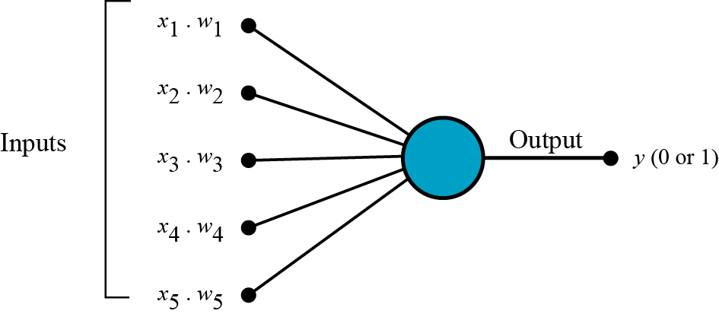
Step 1 . All the inputs x are multiplied with their weights w. Let’s call it k.

Slide 21
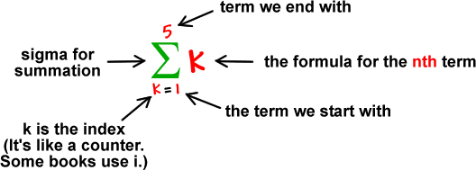
Step 2. Add all the multiplied values and call them Weighted Sum.

Slide 22
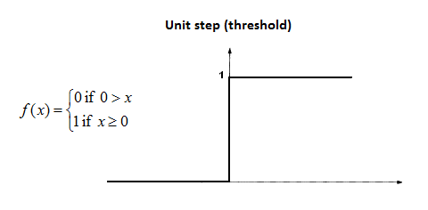
Step 3. Apply that weighted sum to the correct Activation Function.
For Example: Unit Step Activation Function.

Slide 23
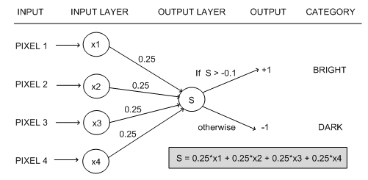
Why do we need Weights and Bias?
Weights shows the strength of the particular node.
A bias value allows you to shift the activation function curve up or down.

Slide 24
Why do we need Activation Function?
In short, the activation functions are used to map the input between the required values like (0, 1) or (-1, 1).
Where we use Perceptron?
Perceptron is usually used to classify the data into two parts. Therefore, it is also known as a Linear Binary Classifier.

Slide 25
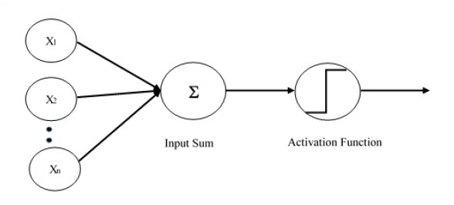
Single layer perceptron (SLP) is the first proposed neural model created. The content of the local memory of the neuron consists of a vector of weights. The computation of a single layer perceptron is performed over the calculation of sum of the input vector each with the value multiplied by corresponding element of vector of the weights. The value which is displayed in the output will be the input of an activation function.
SLP is the simplest type of artificial neural networks and can only classify linearly separable cases with a binary target (1 , 0).

Slide 26
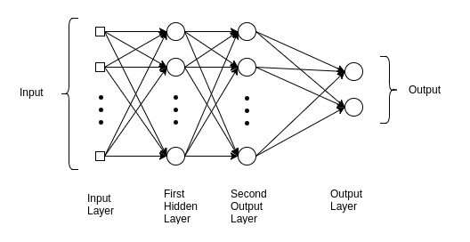
What Is a Multilayer Perceptron?
A multilayer perceptron (MLP) is a perceptron that teams up with additional perceptrons, stacked in several layers, to solve complex problems.The diagram below shows an MLP with three layers.
Each perceptron in the first layer on the left (the input layer), sends outputs to all the perceptrons in the second layer (the hidden layer), and all perceptrons in the second layer send outputs to the final layer on the right (the output layer).

Slide 27
Learning Rules
By learning rule we mean a procedure for modifying the weights and biases of a network. The purpose of the learning rule is to train the network to perform some task.
There are many types of neural network learning rules.
They fall into three broad categories:
supervised learning,
unsupervised learning and
reinforcement (or graded) learning.
Perceptron Learning Rule
Perceptron Learning Rule states that the algorithm would automatically learn the optimal weight coefficients. The input features are then multiplied with these weights to determine if a neuron fires or not.

Slide 28
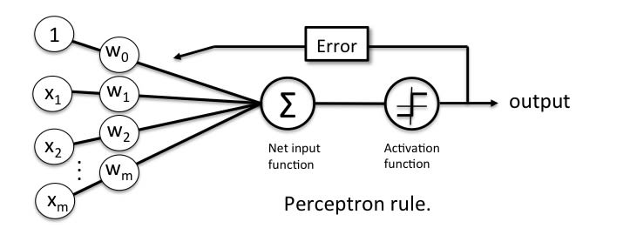
Error in Perceptron
In the Perceptron Learning Rule, the predicted output is compared with the known output. If it does not match, the error is propagated backward to allow weight adjustment to happen.

